Slide 1
Accessibility in Action Awards 2024
Celebrating
Global Accessibility Awareness Day
#GAAD

Slide 2
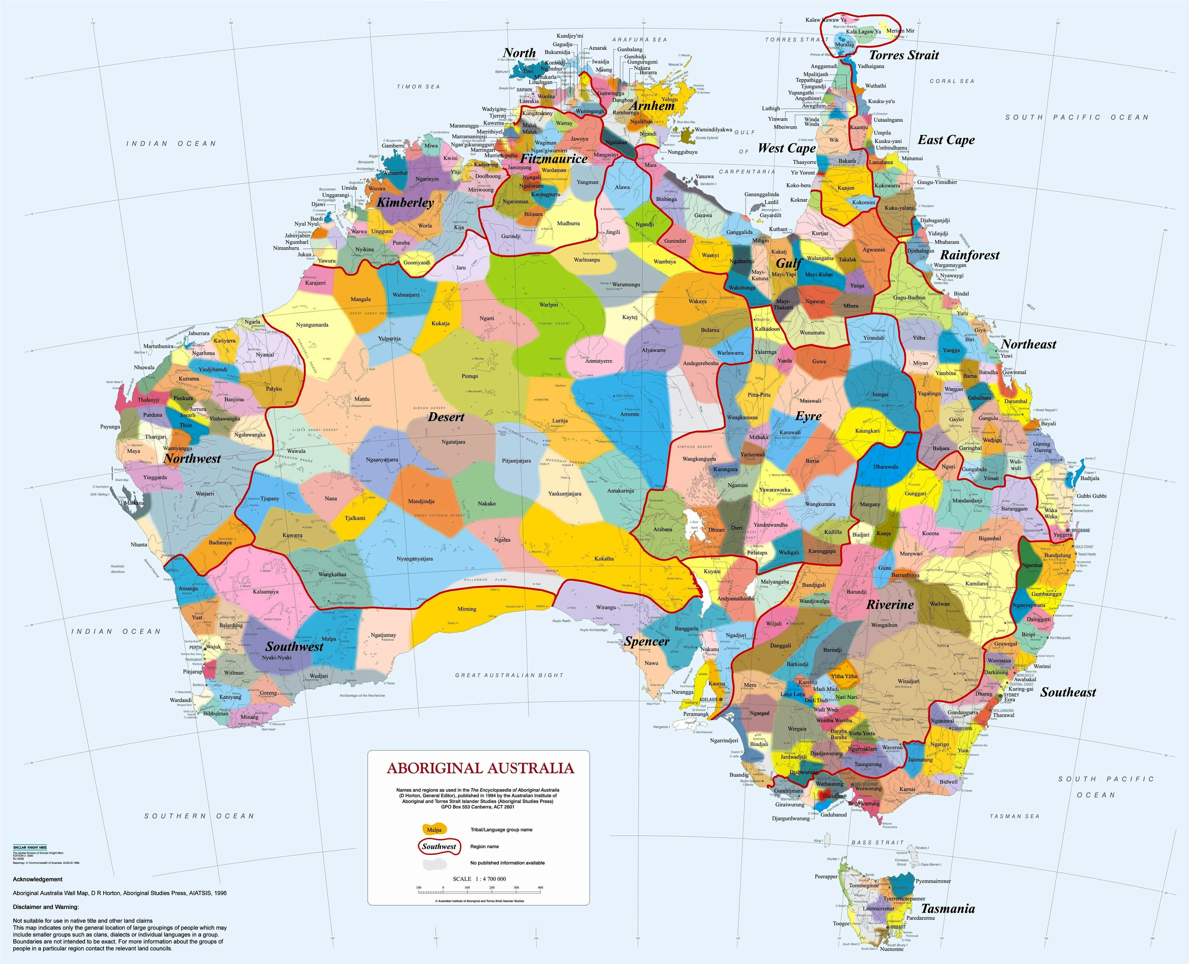
Acknowledgement to country
https://aiatsis.gov.au/explore/map-indigenous-australia

Slide 3
About the
AIA Awards

Slide 4
Individual
Awards
4 winners

Slide 5
John Fardoulis
― TAFE NSW

Slide 6
Drew Burns
― Federation University

Slide 7
Jen Cousins
― Ex - TAFE South Australia

Slide 8
Justin Wylie
― Central Queensland University

Slide 9
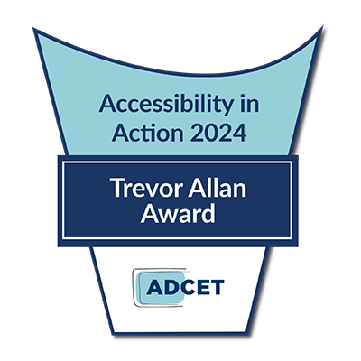
Trevor Allan Award
Excellence in Disability Inclusion
and Accessibility
This award is a prestigious honour that will be bestowed annually upon an individual who has demonstrated a sustained and unwavering commitment to promoting accessibility and inclusion for students with disability in tertiary education across Australia. Named after Trevor Allan, a renowned champion and leader in the disability and tertiary sector, this award recognises and celebrates those who have made significant and sustained contributions to creating an equitable and inclusive learning environment for all students.

Slide 10
Trevor Allan Award
Excellence in Disability Inclusion
and Accessibility
Cathy Easte
― Griffith University

Slide 11
Team
Awards

Slide 12
Highly
Commended
2 winners

Slide 13
Enabling quadriplegic specialist doctor’s training & creating an inclusive precedent
Australian College of Rural and Remote Medicine
Dr. Dan Halliday, Dr. Matthew French, Dr. Mike Hurley, Dr. Elizabeth Prictor,
Dr. David Campbell, Bethany Luxford, Dr. Greg Gladman and the ACRRM team

Slide 14
Hearing Augmentation Over Wi-Fi & valuing students' lived experiences
University of Technology Sydney
Danny Tan, Alex Ruch, Renee Jones, Lucian Sutevski, Liz Penny, Jyoti Di-Cola,
Scott Britcher, Karin Senff, Jarad Avnell

Slide 15
Team
Awards
10 winners

Slide 16
HDS727 - Auslan and the Deaf Community Course
Deakin University
Dr Amie O'Shea, Ramas McRae, Haley Martin, Maz Thomas, Paula Thornton

Slide 17
Inclusive medical training, enabling students and doctors with disability to pursue careers in medicine
The Emergency Department of the
Gold Coast University Hospital
Dr. Mohammed Raisuddin, Dr. Shahina Braganza, and Jessica Weatherall

Slide 18
QUT004 QUT You: Living and Working Collaboratively, Ethically, and Inclusively
Queensland University of Technology
Professor Linda Graham, A/Prof Jenna Gillett-Swan, Lara Maia-Pike

Slide 19
Accessibility Champions Project
Deakin University
Bex Carruthers, Tara Draper, Michael Wright, Lisa Foster, April Bjork, Bec Muir, Mary Rabahi, Mahen Jayawardena, Karen Lake, Pennie White, Bhavya Dhamankar, Ambili Sasidharan, Angie Williamson, Danni Hamilton, Elizabeth Bhavya,
David Eckstein, Ismail Zengin, Nicolas Bennet, Francesca Bussey, Kim Jones, Matthew Griffiths, Puva P Arumugam, Tricia Ong, Kat Cain,
Liza Marsh, Shane McIver, Darren Britten

Slide 20
Equity-First Student as Partners: Students Mentoring Staff
Deakin University
Cassandra Iannucci, Sam Geddes, Lisa Hanna

Slide 21
Artificial Intelligence in Learning and Teaching – an Educator Course
RMIT
Aisha Jirjees Ahmed, Priscilla-Anne Green, Alyce Greenwood, Shona Leitch, Dale Leszczynski, Helen McLean, Nick McIntosh, Michelle Staniczenko, Hilary Wheaton

Slide 22
Embedding accessibility and inclusion using innovative practices
TAFE NSW
Naomi McGrath, John Fardoulis, Kathy Simic, Stephen Belbin,
Carla McMillan, Sue Wakefield, Mia Lahey Rudd, Kerrie Hammond,
Teresita Eslava, Gail Mercado

Slide 23
Welcome Week - Orientation for Neurodiverse Students
University of Newcastle
Katy Lambert, Georgie Kerr, Katrina Hamal, Dianne Kirby

Slide 24
Building Tiered Support for Neurodivergent Students
Edith Cowan University
Hannah Pickup, Emma Lewin

Slide 25
Student Web Uplift
Deakin University
Fiona Greig, Steven Richards, Megan Smith, Cheryl Young,
Lauren Gwyn, Abby Smith, Jessica Kalamaris

Slide 26
Congratulations

Slide 27
Coming up!
Look out for some of our amazing winners in webinars, podcasts and articles!
For more information on AIA visit:
www.adcet.edu.au/our-work/accessibility-in-action-award

Slide 28
Congratulations
& Thank You

