Slide 1
Fostering Inclusive Learning: Southern Cross Model Unit Sites Standards
Polly Lai, Kelly Hill, Ruth Greenaway and Alison Bundock
Centre for Teaching and Learning
12 June 2024

Slide 2
Today’s Outline
What is the Southern Cross Model (SCM)?
Why does SCM need Unit Site Standards?
The Framework of SCM Unit Site Standards
Implementation
Q&A

Slide 3
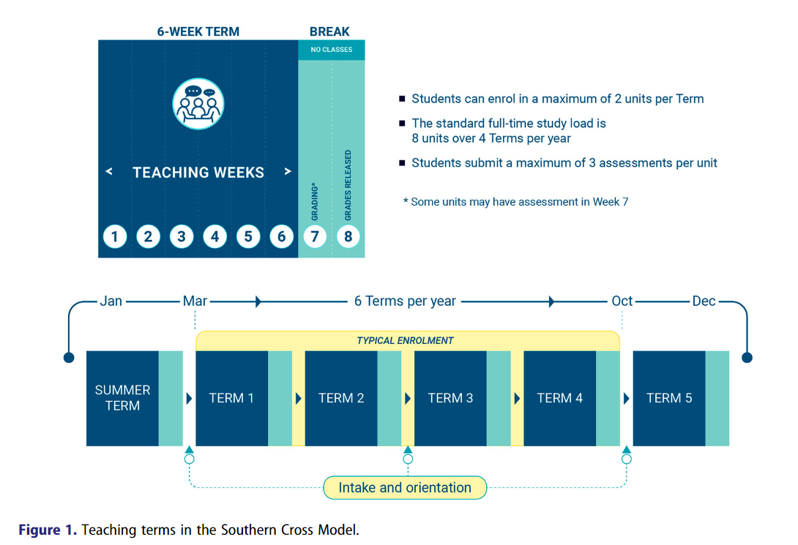
Term outline

Slide 4
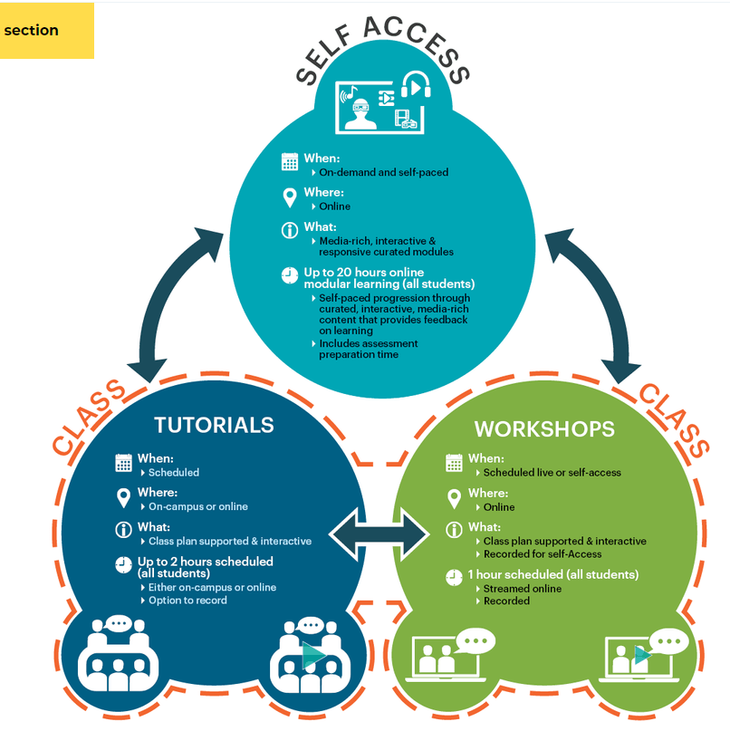
What is the Southern Cross Model?
A live, online, interactive class timetabled once a week, typically for 1-hour online only, regardless of on-campus or online enrolment. The workshop will be recorded and uploaded to learning sites each week.
A live, interactive class timetabled once a week with online and on-campus options depending on students’ enrolment mode.

Slide 5
The Learning Structure of the SCM
Week 1
Self-Access Learning: Module 1
 | Workshop |  | Tutorial
Week 2
Self-Access Learning: Module 2
 | Workshop |  | Tutorial
Ass 1
Week 3
Self-Access Learning: Module 3
 | Workshop |  | Tutorial
Week 4
Self-Access Learning: Module 4
 | Workshop |  | Tutorial
Ass 2
Week 5
Self-Access Learning: Module 5
 | Workshop |  | Tutorial
Week 6
Self-Access Learning: Module 6
 | Workshop |  | Tutorial
W7
Ass 3

Slide 6
Why does SCM need Unit Site Standards?
Quality Assurance
Accessibility and Inclusivity
Uniformity
Student Orientation
Academic Development
Pedagogical Effectiveness
Enhanced Student Engagement
Assessment & Evaluation
Technology-enhanced Learning

Slide 7
Accessibility and Inclusivity
Accessibility and Inclusivity
Equal Access: to ensure that all students have equal access to learning materials and opportunities. This includes adherence to web accessibility guidelines (such as WCAG).
Universal Design for Learning (UDL): to incorporate UDL principles to create flexible learning environments that can accommodate individual learning differences. This involves providing multiple means of representation, engagement, and expression to support all learners.

Slide 8
Where are SCU students?
SCU
17,729
Lismore
Gold Coast
Coffs Harbour
Sydney
Hayman Island
Perth
PNG
China
Online
Brisbane
Melbourne

Slide 9
The Framework of SCM Unit Sites Standards
The SCM Unit Site Standards are underpinned by established online learning theories: Three Types of Interaction (Moore, 1989), Online Community of Inquiry (Garrison & Akyol, 2013), and Constructive Alignment (Biggs, 2011).
The criteria within each domain of the framework were established with reference to the ACODE Benchmarks, the TELAS Framework, Quality Matters and the three pillars of The Universal Design for Learning (UDL) Guidelines.
Teaching presence and communication
SCM
Constructive alignment and assessment
Learning materials and activities

Slide 10
The Framework of SCM Unit Sites Standards cont.
Supports the UDL guidelines of providing multiple means of action and expression:
Physical Action
Expression & Communication
Executive Functions
Supports the UDL guidelines of providing options for:
Executive Functions
Comprehension
Teaching presence and communication
SCM
Supports the UDL guidelines of providing multiple means of engagement and representation:
Recruiting Interest
Sustaining Effort & Persistence
Self-Regulation
Perception
Language & Symbols
Comprehension
Constructive alignment and assessment
Learning materials and activities

Slide 11
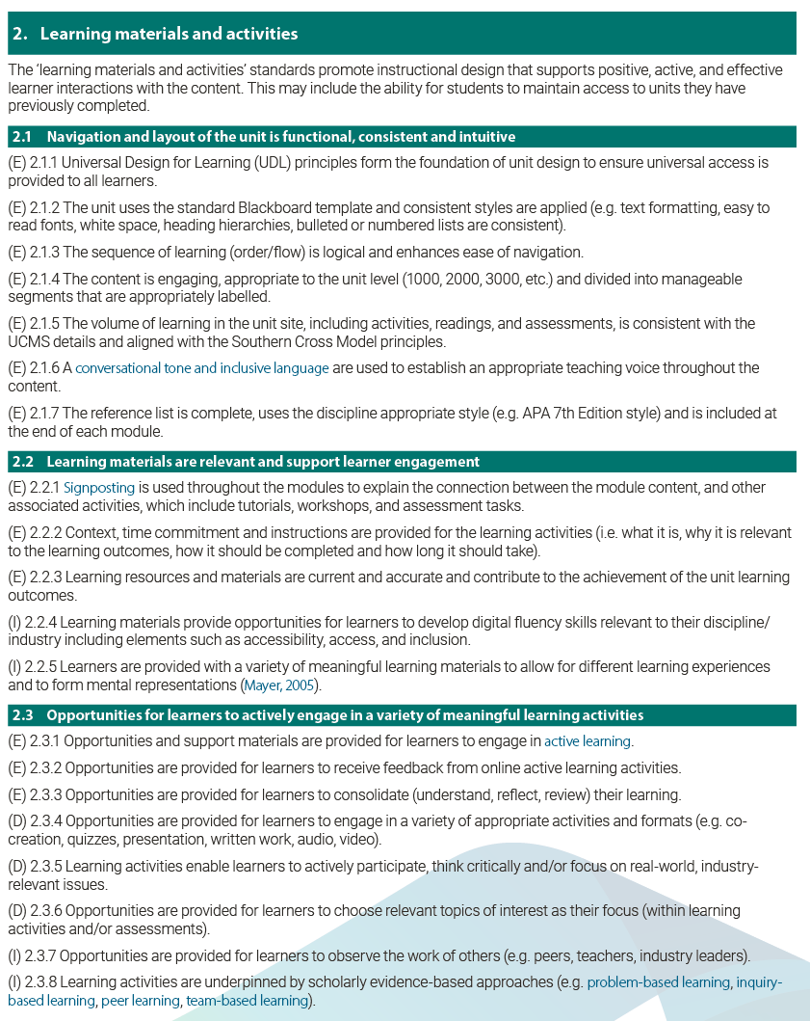
Implementation of SCM Unit Site Standards
Each standard within a domain is categorised by the following key.
(E) Established – minimum
(D) Developing – as a priority
(I) Innovative – for the future

Slide 12
The SCM Unit Site Standards can be used:
as a reference or guide when designing and developing a unit
by Educational Designers at CTL to evaluate units and/or for collaborative discussions with academic staff to address identified needs or potential enhancements
by academic staff as a self or peer-assessment tool to reflect on their unit sites.

Slide 13
Questions

Slide 14
References
Biggs, J. & Tang, C. (2011). Teaching for Quality Learning at University. McGraw-Hill Education
CAST (2018). Universal Design for Learning Guidelines version 2.2. Retrieved from http://udlguidelines.cast.org
Goode, E., Roche, T., Wilson, E., & McKenzie, J. W. (2023). Implications of immersive scheduling for student achievement and feedback. Studies in Higher Education, 1-14.
Garrison, D. R., & Akyol, Z. (2013). Toward the Development of a Metacognition Construct for Communities of Inquiry. The Internet and Higher Education, 17, 84–89.
Mayer, R. (2005). The Cambridge Handbook of Multimedia Learning. Cambridge University Press.
Moore, M.G. (1989). Three Types of Interaction. American Journal of Distance Education, 3(2), 1–7.
Southern Cross University (2023). Annual Report 2023. Retrieved from https://www.parliament.nsw.gov.au/tp/files/188625/Southern%20Cross%20University%20Annual%20Report%202023.PDF

