Slide 1
UDL-LevelUp
Implementing inclusive practices in online courses

Slide 2
Introduction
A co-designed approach to developing a capability tool to integrate UDL principles into online teaching and learning
How inclusive practices can be embedded in the design process to enhance the accessibility, usability, flexibility, and engagement of educational materials

Slide 3
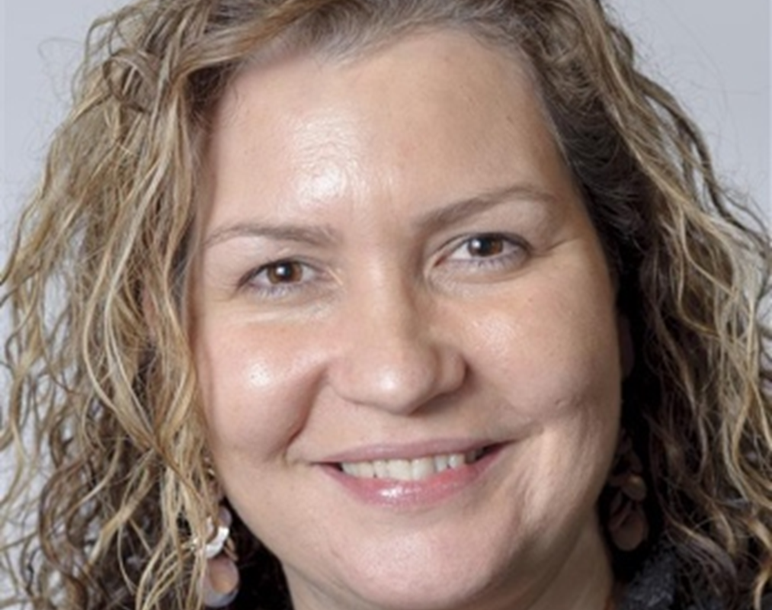
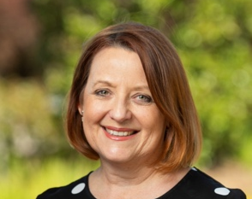
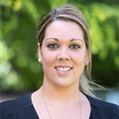
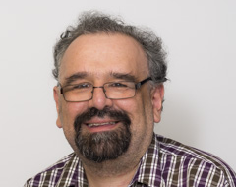
Meet the project team
Tanya Allan (she / her)
Teaching and Learning Specialist, Technology Enhanced Learning
TAFE SA, Erawirung Country
Trina Bianchini (she / her)
Teaching and Learning Specialist, Accessibility and Inclusive Education
TAFE SA, Kuarna Country
Naomi McGrath (she / her)
Project Manager Inclusive Design, Educational Quality
TAFE NSW, Gumbaynggirr Country
John J Fardoulis (he / him)
Lead Universal Design, Educational Quality
TAFE NSW, Darkinjung Country

Slide 4
Background
Partnership between TAFE SA and TAFE NSW
UDL in Tertiary Education Community of Practice

Slide 5
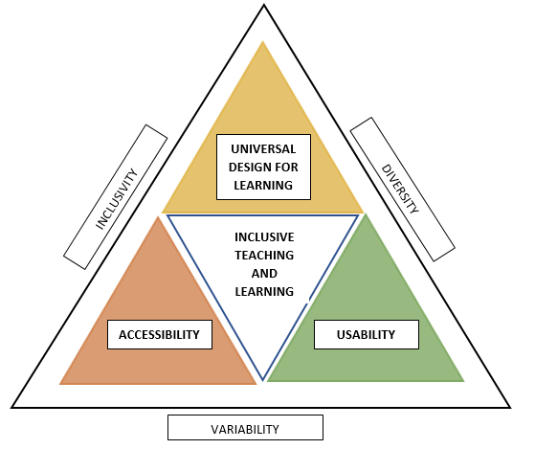
TAFE SA
TAFE SA Digital Toolkit:
Digital Teaching & Learning Standards
Learning Design Planner
Technology Enhanced Delivery (TED) Levels for LEARN
LEARN shell
Inclusive Education Roadmap & Guidelines
LEARN-ED
Inclusive Education Roadmap & Guidelines

Slide 6
TAFE NSW
Educational Quality Framework
Inclusive Design Standards
Accessibility
Communication
Cultural Connection
Universal Design for Learning
Usability

Slide 7
UDL-LevelUp concept
Level 0: Simple design
Level 1: Accessibility
Level 2: Usability
Level 3: UDL enhanced
Inclusive design analysis highlights improvements

Slide 8
Next steps
Finish creating the unit that is contextualised for our organisations
Pilot & collate feedback from staff
Implement changes & roll out
Present to the UDL in Tertiary Education Community of Practice (CoP)
Report back at the 2025 UDL Symposium (if you will have us)

Slide 9
Questions & contact details
TAFE SA
Trina Bianchini <Trina.Bianchini@tafesa.edu.au>
Tanya Allan <Tanya.Allan@tafesa.edu.au>
TAFE NSW
Naomi McGrath <Naomi.McGrath2@tafensw.edu.au>
John Fardoulis <John.Fardoulis@tafensw.edu.au>
UDL in Tertiary Education Community of Practice
Facilitated by TAFE SA in partnership with ADCET
For more information, contact Darlene McLennan <darlene.mclennan@utas.edu.au>
You can register to participate in the UDL Community of Practice

