Slide 1
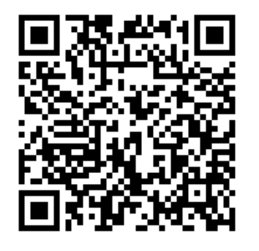
Have ideas about how higher education institutions can help reduce stress during students’ studies?
Engage in co-design and help us understand inclusive and accessible ways high stress can be reduced!
How?
Contribute ideas to a digital whiteboard and/or participate during a focus group or interview for a chance to win 1 of 20 $20 Gift Cards
Who?
Any student aged 18+ studying at an Australian Higher Education Institution (e.g., University)
Find out more

