Slide 1
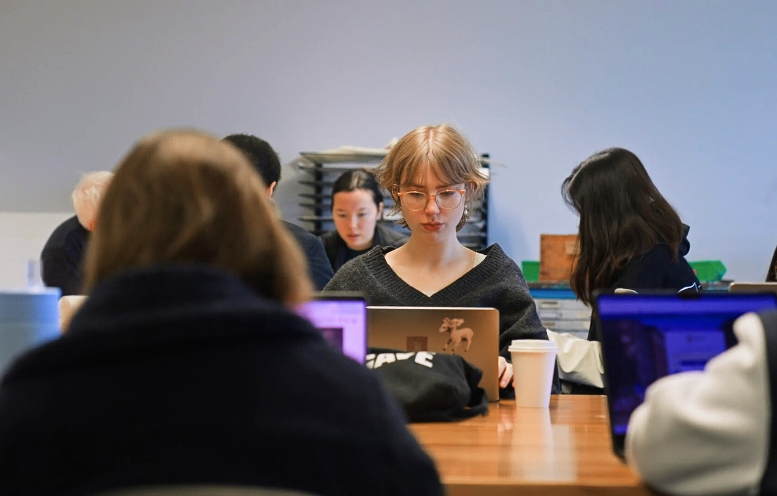
BUILDING
NEURO-INCLUSIVE EDUCATION WITH DIVERSIFIED:
The Power of Collaboration and Co-Production
Diver -
sified:
@DIVERSIFIEDUNSW

Slide 2
SOVEREIGNTY WAS NEVER CEDED
WE GATHER ON
UNCEDED
LAND
SOVEREIGNTY WAS NEVER CEDED

Slide 3
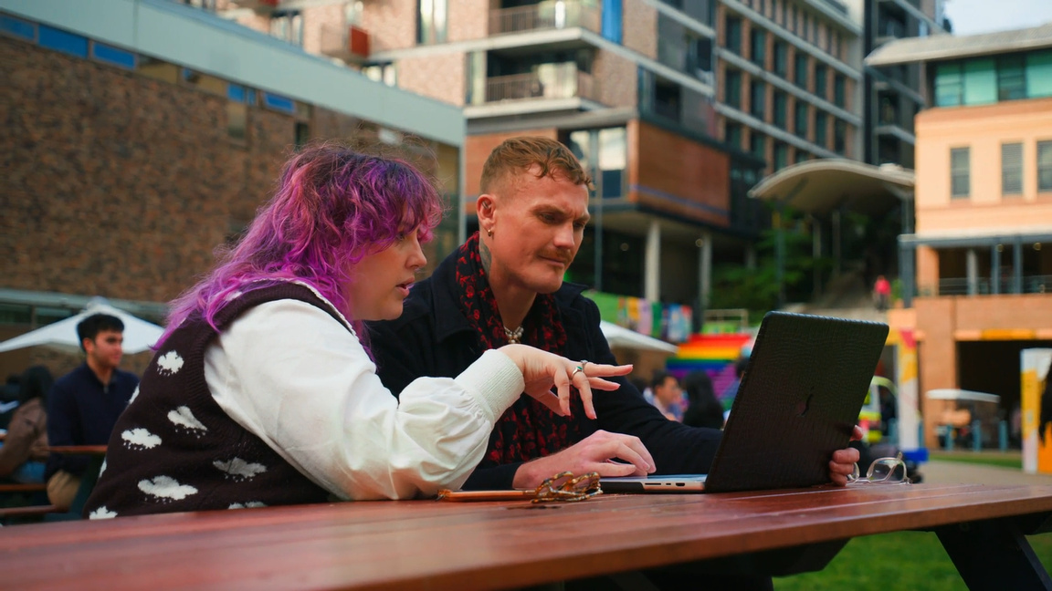
KEY AIMS
Diver -
sified:
1
The Origins of Diversified and our plans for the future
Deepen your understanding of Neurodivergence and the experiences of neurodivergent students
2
Explore the power of collaboration and its role in the creation of our Toolkit for Educators
3
Hear the lived experience of Neurodivergent students navigating higher education.
4

Slide 4
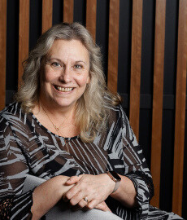
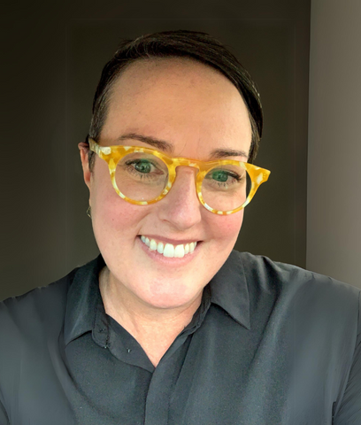
Introducing the Team
Diver -
sified:
Professor Terry Cumming
Aaron
Saint-James
Senior Lecturer
Karen Kriss
Chantel
Le Cross
she/her
he/him
she/her
they/them

Slide 5
ABOUT
DIVERSIFIED
Who We Are
Diversified is a collective of neurodivergent UNSW students, academics, and staff who ensure that neurodivergent people are part of the conversations that impact them. Through the development of research, resources, and awareness campaigns, Diversified aims to embed neuro-inclusion into UNSW’s educational framework and policies.
Collaboration | Innovation | Empowerment
Amplify Neurodivergent Perspectives
Promote Inclusive Education
Facilitate Collaboration

Slide 6
WHAT WE MEAN WHEN WE SAY
Access to Diagnosis and Support
We also recognise that access to diagnosis and support is not always equitable.
Economic, social, and systemic barriers such as
Neurodivergent
Celebrate the diversity of human minds
Gender
Culture
Acknowledge social and economic barriers
Language
Visa Status
Economic
Policy
ADHD
OCD
Autism
Dyslexia
Disclosure
Disclosure is a personal choice
Dyspraxia
Dyscalculia
Neurodivergent people make valuable contributions whether their identity is known or not.
Tourette Syndrome
Intellectual Disabilities
Diver -
sified:

Slide 7
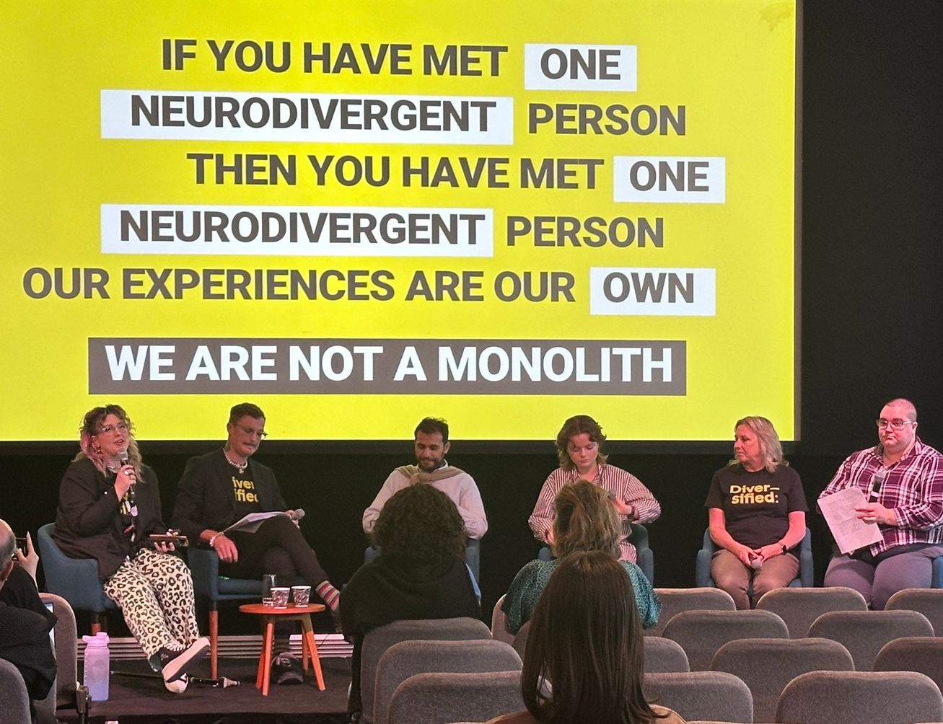
NEURODIVERSITY:
Disabillity is not inability
Pathology Paradigm
Neurodiversity Paradigm
There is a normal brain
Normal is a social construct
Label behavior based on external observation
Understands behavior through lived experience
Compliance is the goal
Autonomy is the goal
Deviation from normal seen as deficit/disorder
Deviation from “normal” seen as part of diversity
A strength based approach
Diver -
sified:

Slide 8
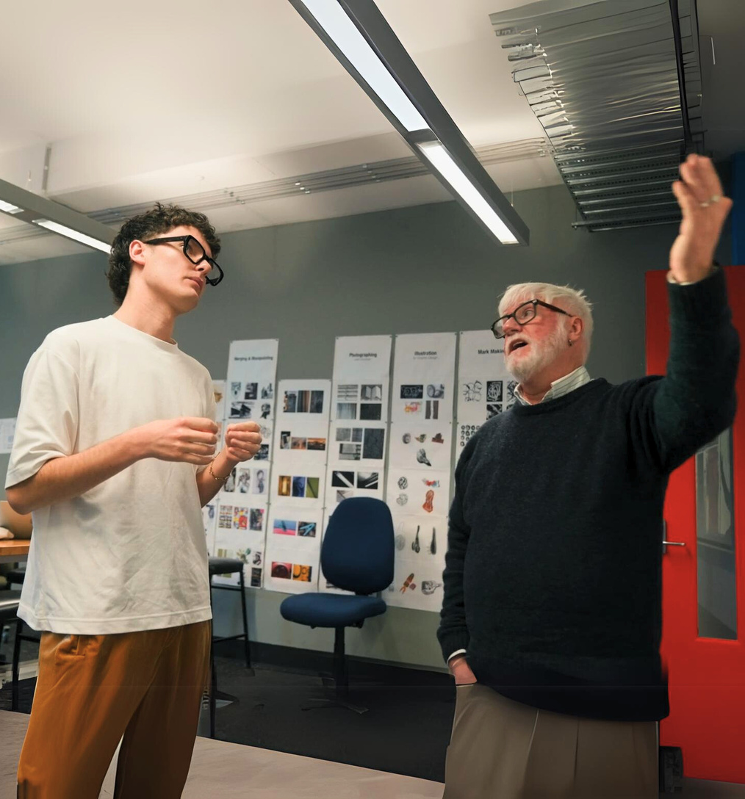
BARRIERS:
Neurodivergent students face
Rigid Learning Environments
Sensory Overload
Communication Barriers
Organisational demands
Psycho-social Barriers
Information Processing Differences
These environmental barriers highlight the need for more adaptable systems that accommodate a diverse range of learning needs.
Diver -
sified:

Slide 9
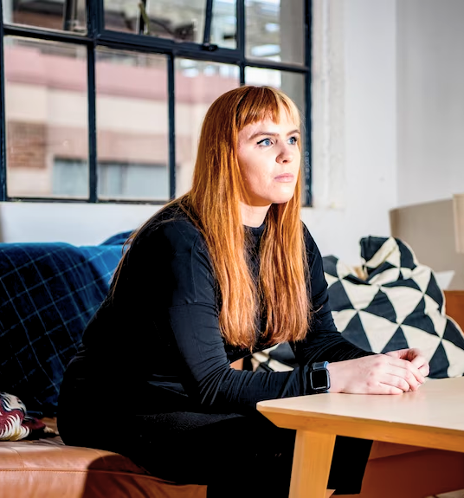
JOSIE’S STORY:
The beginning of Diversified
Identifying a Barrier: Inaccessible assessment briefings
Adapt & Problem Solve: Redesigns the briefing for their needs
Self Advocacy: Presented the solution to their educator
Collaboration: Educator recognises the value and collaborates
Integration: Embeds these changes into their course design
Awareness: Sees the need for more change in other areas
Diver -
sified:

Slide 10
AARON’S STORY:
Student-Academic reciprocity and empowerment
Breaking Boundaries: Redefining, Empowering, Innovating
Empowering Collaboration: Bridging, Transforming, Solving
Student-Led Change: Initiating, Leading, Proving
Being the Change: Advocating, Transforming, Including
Creating Opportunities: Writing, Advocating, Achieving
Peer Recognition: Validating, Impactful, Recognising
Inspiring Action: Standing, Changing, Overcoming
Diver -
sified:

Slide 11
THE POWER OF COLLABORATION:
One Size Fits All
The “one size fits all” approach makes students feel that they need to fit in to participate. This reinforces neuro-normativity and creates a culture that impacts students' sense of belonging, learning engagement and mental health.
Utilising the student voice for impactful education
Research has demonstrated that dialogical co-production and/or co-design partnerships can be a powerful way to promote more collaborative and responsive approaches to teaching and learning in higher education
Identifying Challenges
Challenges extend beyond achieving good grades and maintaining academic performance. Systemic and institutional change is required in order to make lasting change.
Cook-Sather, 2018
Marquis et al., 2019
Higgins et al., 2019
What Students Need
Ensuring neurodivergent students feel recognised, comprehended, and cherished is essential in ensuring that neurodivergent students don’t fall through the cracks.
Diver -
sified:

Slide 12
COLLABORATING WITH STUDENTS:
Findings from our initial Workshops with neurodivergent students
Spaces: Environments, Infrastructure, Technology
Administration/Processes
Student Identity and Culture
Staff and Academic Culture
Each area was further broken down into levels: Systemic, Faculty/School, and Course/Instructor.
Diver -
sified:

Slide 13
UDL & NEURODIVERSITY:
Engagement
the why of learning
Students engage with content in different ways.
UDL encourages varied engagement options to spark curiosity and maintain motivation. For example, offering group work, individual projects, or hands-on activities.
Unlocking opportunities for Neurodivergent students
Embeds flexibility in course from the start
Representation
the what of learning
Facilitates strength based learning
Learners perceive and process information differently. UDL promotes presenting information in diverse formats, such as text, video, and images, making content accessible for all students.
Further thoughts
Imagine how removing barriers from the beginning—rather than addressing them later—could change the way students experience learning. What would a class room that embraces students differences look like?
Action & Expression
the how of learning
Students express their knowledge in different ways. UDL supports offering multiple ways for students to demonstrate their understanding through writing, presentations, or creative projects.
Diver -
sified:

Slide 14
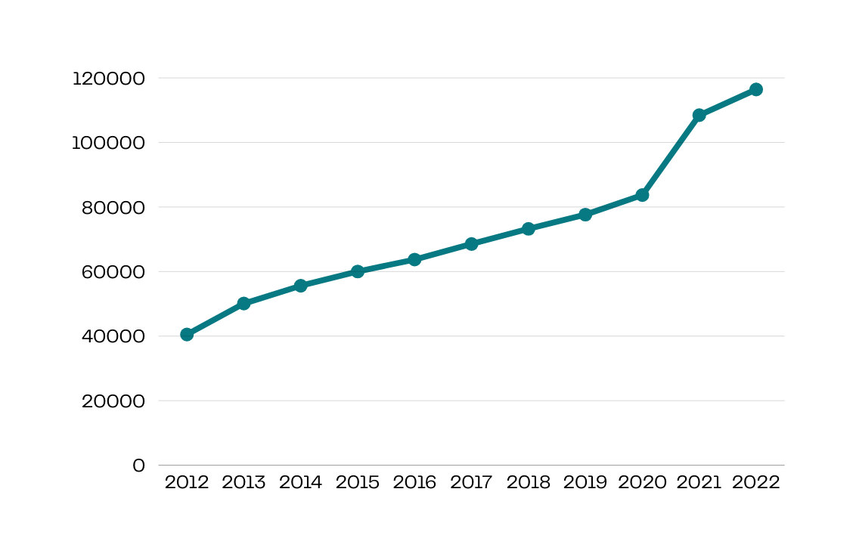
A GROWING POPULATION:
The number of students with disabilities in higher education has more that doubled.
Students slipping through the cracks
Growth in domestic undergraduate enrolments in higher education,
(G Cadby, T Pitman, P Koshy, 2024)
Diver -
sified:

Slide 15
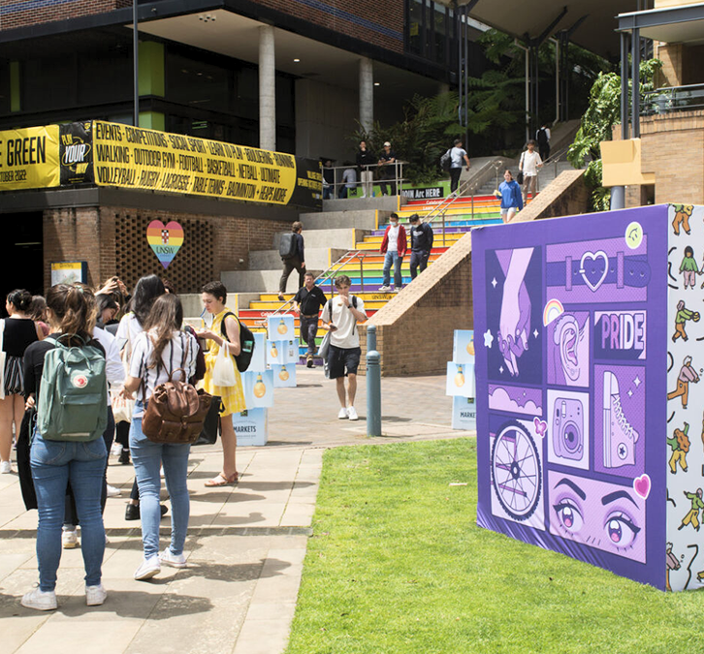
A GROWING POPULATION:
10.6%
5.4%
Students slipping through the cracks
Population Cohort
Lower Success Rate
In 2022 domestic undergraduate students were registered as living with a disability
Despite this growth, their success rate is lower compared to non-disabled students.
2.3%
8.9%
Lower Satisfaction
Lower employment
Students with disabilities are less likely to rate their overall experience positively compared to their non-disabled peers
Graduate outcomes for those with disabilities are less likely to achieve full time employment compared to their non-disabled peers
Diver -
sified:

Slide 16
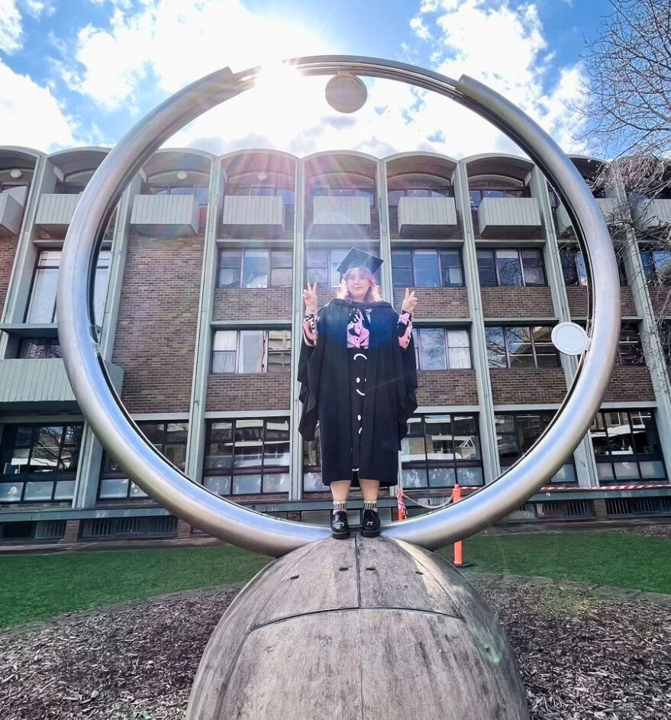
CHANTEL’S STORY:
Redefining success through education and leadership
Early Achiever: The gifted child to burnt out adult pipeline
Barriers to Diagnosis: misunderstood & misdiagnosed
Chronic Illness & Disability: adapting to new challenges
Career Shift: Reexamining expectations and opportunities
COVID’s Impact: The world went quiet & suddenly I could hear
The Power of Education: The impact of withholding access
Redefining Leadership: One that allows complexity & dignity
Diver -
sified:

Slide 17
OUR TOOLKIT
FOR EDUCATORS
Foundational elements of the Toolkit:
Best Practices from UDL Literature
Neurodivergent Student Insights
Instructor Feedback
Organisational demands
Support and Recognition
Collaborative Co-Design
Diver -
sified:

Slide 18
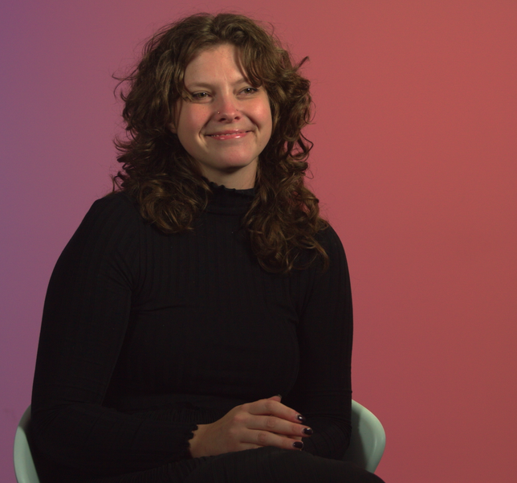
WHAT’S IN THE TOOLKIT?
INCLUSIVE LEARNING CHECKLISTS
IMPLEMENTATION ROADMAP
SUPPORTING VIDEO SERIES
Inclusive Learning Environment & Culture
Effective Communication & Student Voice
Digital Platforms & Assistive Technologies
Successful Collaboration
Student Autonomy & Providing Choice
A step by step guide on how to implement the checklists into your course design, delivery and how our supporting videos can help you throughout the process.
Six videos designed to deepen your understanding of neurodivergence and gain insight into the student experience from the lived experience of UNSW neurodivergent students.
Diver -
sified:

Slide 19
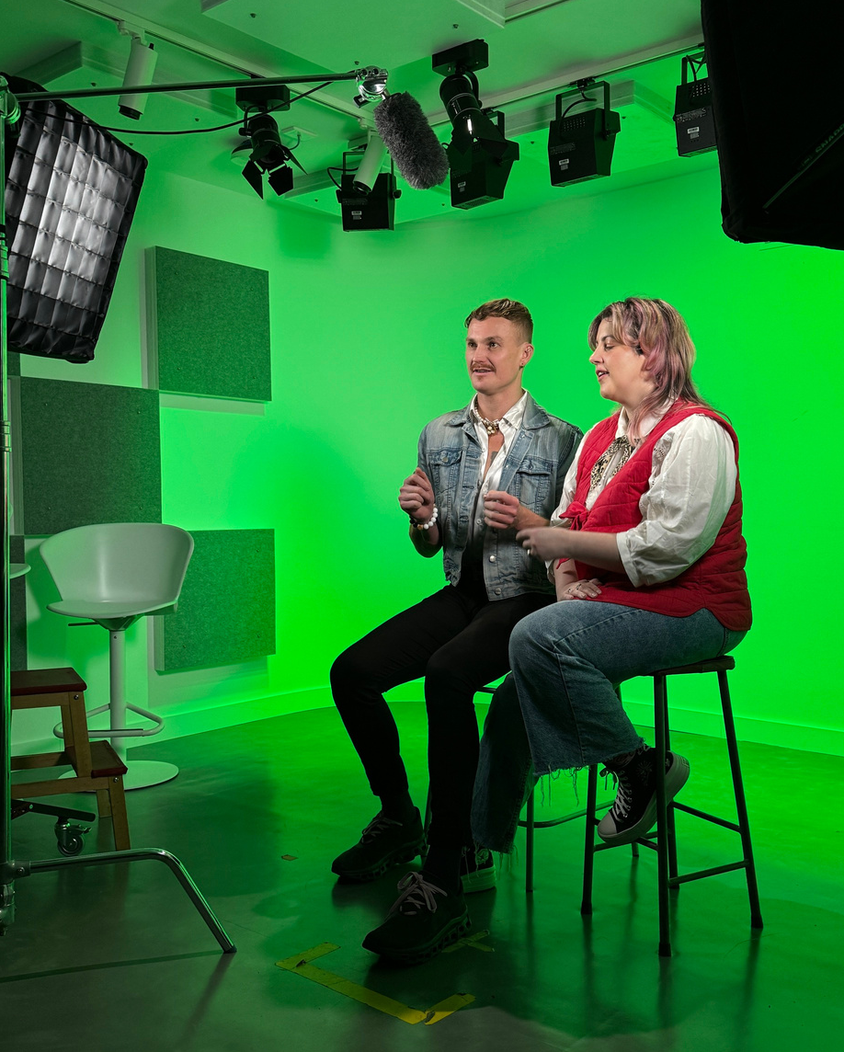
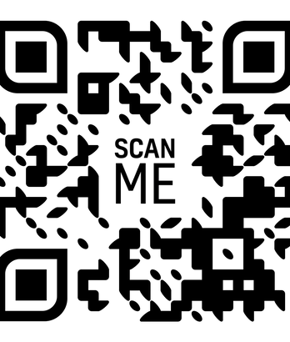
CLOSING THOUGHTS
By advocating for yourself and others, you have the power to initiate meaningful change. Don’t wait for opportunities
—create them.
THANK YOU
— sign up for our newsletter.
Diver -
sified:

